Slide 1

Software Design Document
Group 18

Slide 2
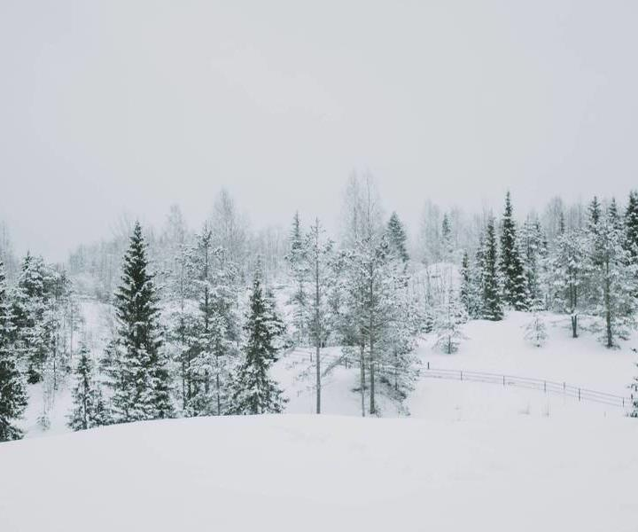
INTRODUCTION
Design Phase of our system we are going to perform UML analysis bringing out the actors, classes and use cases. We make use for class diagram, use case diagram, activity, and sequence diagram to explain our use cases.

Slide 3
System Analysis
Actors
Classes
Use Cases
1). Primary
Donor
Collector
Admin
2). Secondary
System
Admin
Third-Party
Users
Collector // inherit user
Donor // inherit user
Admin // inherit user
Post
History
Messaging
Notification
Wallet
Transaction
The uses cases represent the processes of our system
Registration
Login
Logout
Forgot password
Create food post
Collect food post
Make deposit into wallet
Recommend Donor
Messaging(chat)
Upload photo

Slide 4

The flow and connection of the system can be shown using a class diagram. The class diagram bellow shows the connection and dependences between the classes. The class diagram can be used to generate the ERD of the system.
Class Diagram

Slide 5
The interaction between this the use case and their constrains is shown by the help of a use case diagram.
Use case Diagram

Slide 6
To give us a behavioral view we decided to model the flow of the system in terms of the two major activities of the system in an activity diagram.
Activity Diagram

Slide 7

Sequence Diagrams
The Development of our system needs detail description and so we try to implement most of our meaningful use cases as sequence diagrams to show the flow of each use case

Slide 8
The sequence diagram explains the registration process of our application.
Registration Sequence Diagram

Slide 9
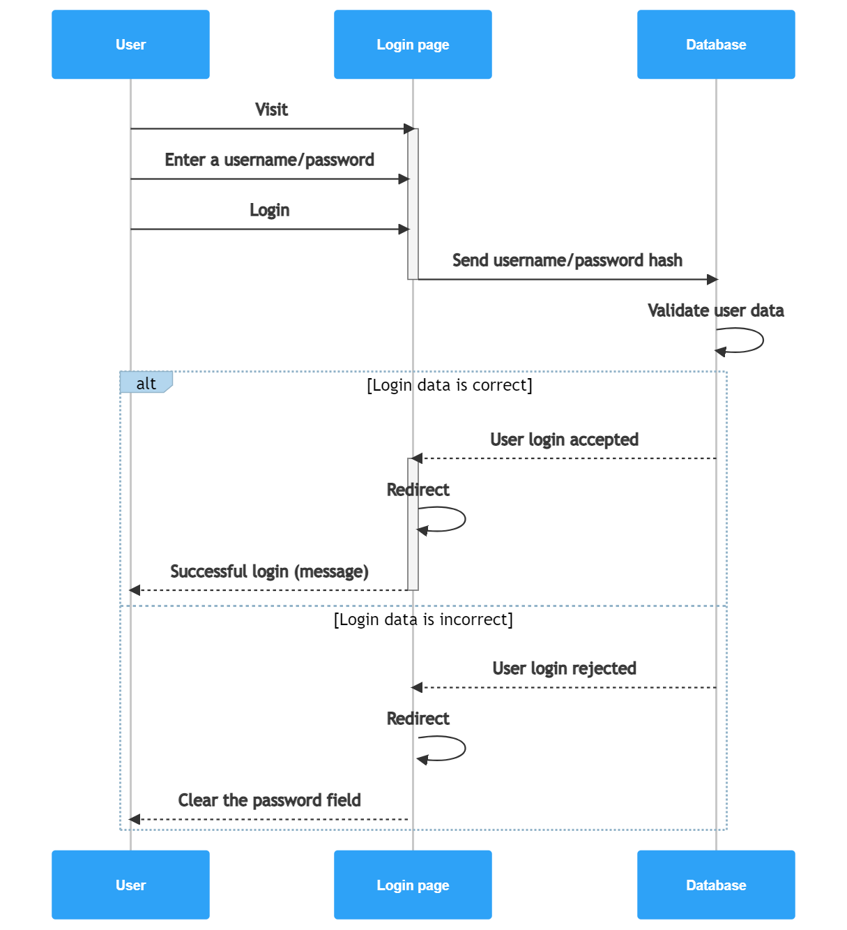
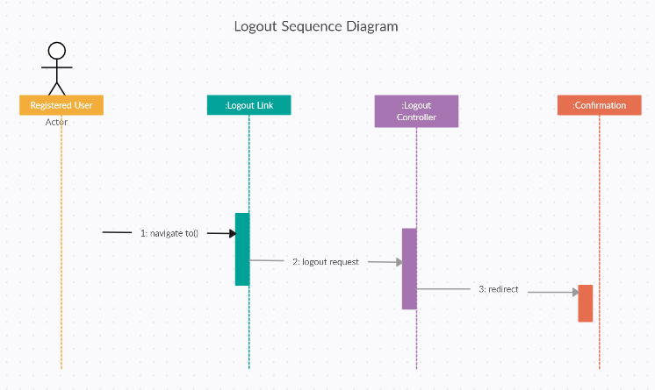
The sequence diagram explains the login process of our application.
Login/Logout

Slide 10
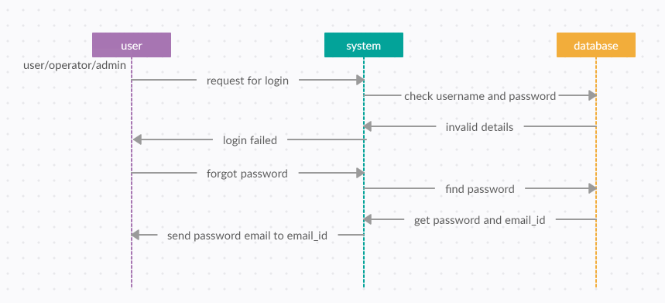
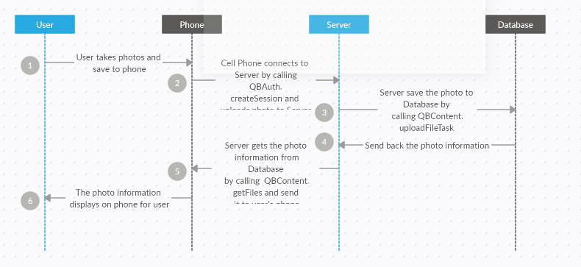
The system comes with a forgot password to ensure security, reliability, and usability we model this into a sequence diagram to show the follow of the process. Uses are allowed to upload post image as explained by the sequence diagram bellow.
Forgot Password/upload image

Slide 11
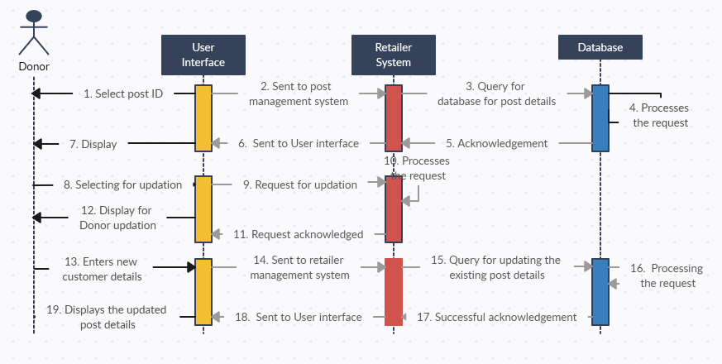
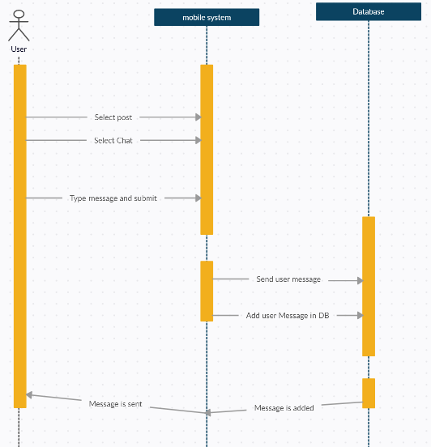
*User have the ability to modify their post for example mark unavailable *Users have the ability to chat with each other but that most be on the basses of a food post
Update post/messaging

Slide 12
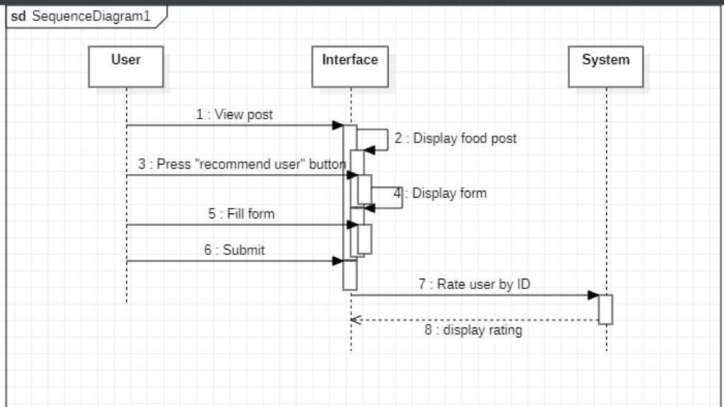
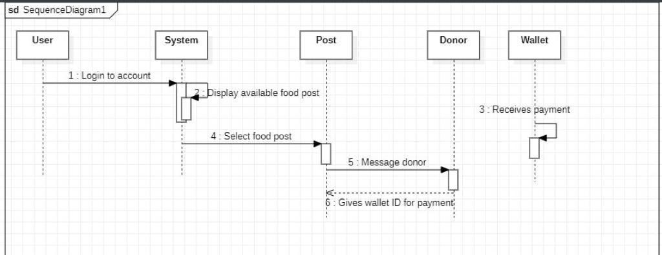
*In our system collectors can recommend donors as a form of encouragement
Update post/messaging

Slide 13
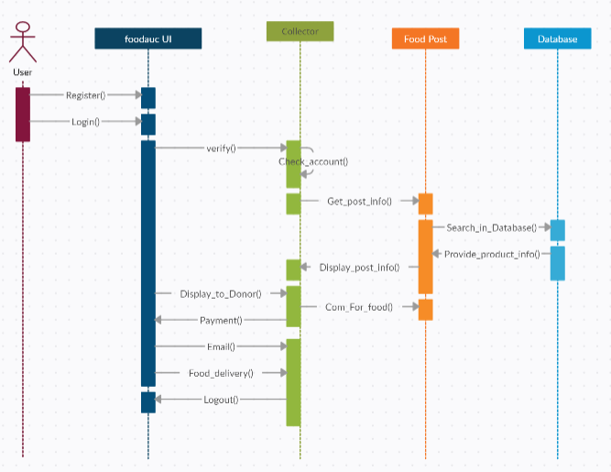
Collect Food
People come to our application is used by users to collect food from donors. A sequence diagram is designed to provide development steps on how the food collection process happens including the followed up money transferee.

Slide 14
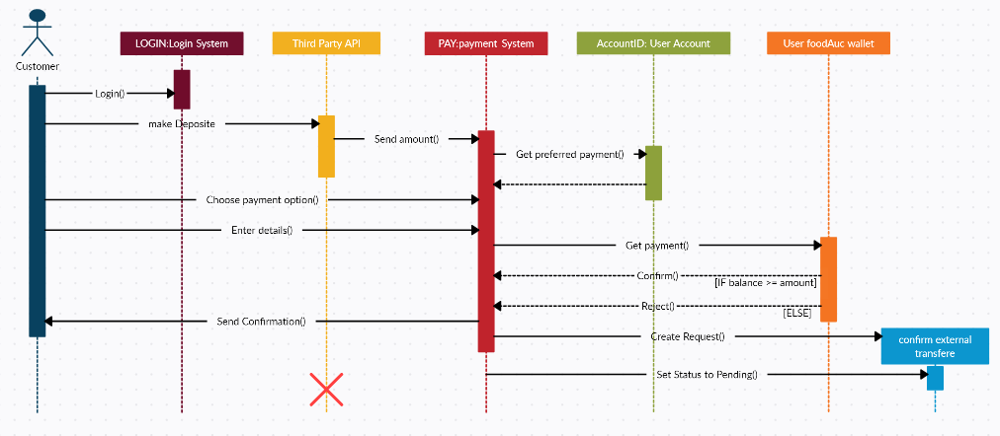
Deposition
Our system comes with a wallet which allow deposit, transfer and withdraw. The process to deposit money into your wallet account. Transfer money from one account to another. The process of development of this use cases is displayed bellow
.

Slide 15
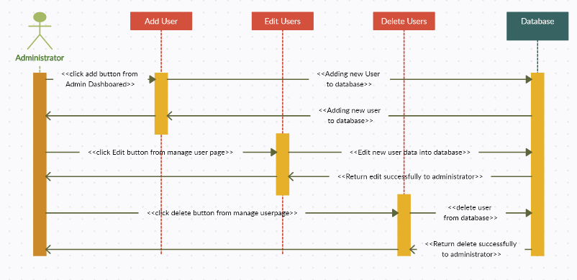
The admin does monitor the system from users, post, and transactions, it in this capacity that the admin works as a secondary actor to the system. The sequence diagram bellow shows how the admin manages user of the system by performing add, delete edit actions on the user I information
Manage users

Slide 16

THANK YOU
Group 18

